Slide 1
Engineering Chemistry F. Y. B. Tech. (Div. G)
Dr. Jitendra Satam

Slide 2
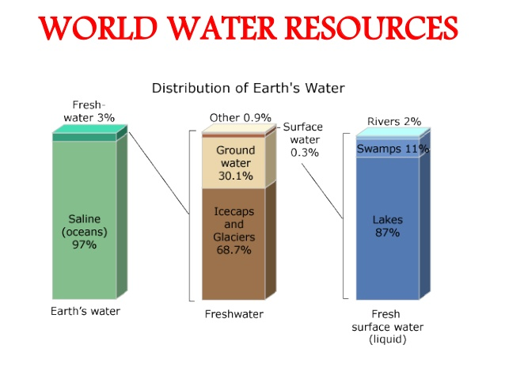

Slide 3
Sr. No. | Industry | AVG. Volume e of Waste water per unit of product | Percentage reuse achievable
1 | Thermal Power Plant | 155×10³ lit/hr/MW | 98
2 | Pulp & Paper | 250×10³ lit/ton | 50
3 | Iron & Steel | 150× 10³ lit/ton | 40
4 | Pharmaceutical | 45× 10³ lit/kg | 40
5 | Distillery | 1.5 lit/lit of alcohol | 25
6 | Textile | 250 lit/kg. Cloth | 15
7 | Tannery | 34 lit/kg. Of raw hides | 12

Slide 4
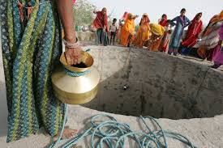
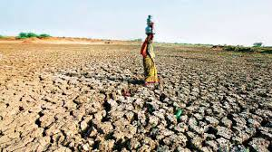
ISSUES WITH WATER IN INDIA
River Pollution
Water Conflicts
Ground Water depletion
Poor water Management
Inadequate storage capacity

Slide 5

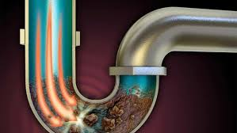
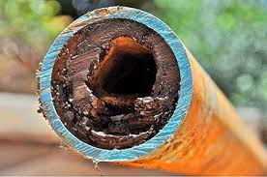
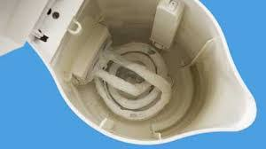
Hard water in industry

Slide 6
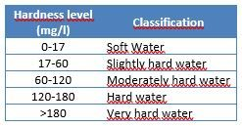
Classification of Hardness

Slide 7
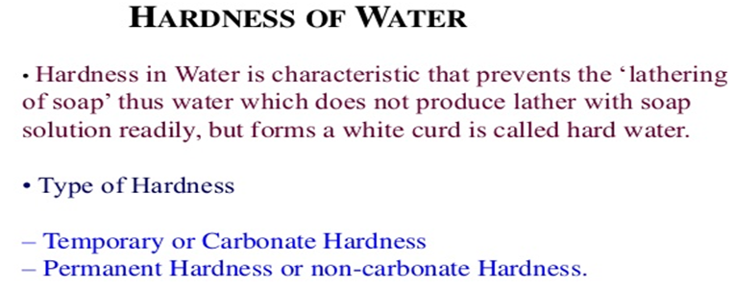
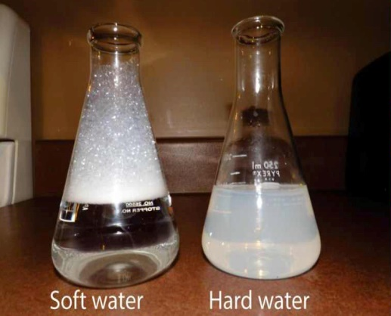

Slide 8
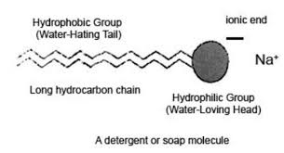
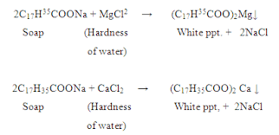
Reaction of Soap with Water

Slide 9
How to detect hardness?
When the water is treated with soap solution, if it prevents lathering and forms white scum, the water contains hardness. Or Water containing hardness, gives wine red colour with Eriochrome Black –T indicator.
Although water hardness usually measures only the total concentrations of calcium and magnesium (the two most prevalent, divalent metal ions), iron, aluminum and manganese may also be present at elevated levels in some geographical locations. The predominant source of magnesium is dolomite [Ca-Mg(CO₃)₂].

Slide 10
TYPES OF HARDNESS
Depending upon the types of dissolved salts present in water, hardness of water can be classified into two types:
Temporary Hardness
(Carbonate hardness or Alkaline hardness)
Permanent Hardness
(Non carbonate hardness or Non alkaline hardness)

Slide 11
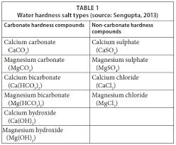
Types of Hardness

Slide 12
Temporary Hardness (or) Carbonate Hardness (CH) (or) Alkaline Hardness
Temporary hardness is caused by carbonate, bicarbonate and hydroxide of calcium and magnesium ions in the water. It can be removed by boiling water or by the addition of lime [Ca(OH)₂]
Boiling promotes the formation of carbonate from the bicarbonate and precipitates calcium carbonate out of solution, leaving water that is softer upon coving.
Ca (HCO₃)₂→ CaCO₃ ↓+ H₂O + CO₂

Slide 13
Permanent Hardness Non – Carbonate Hardness (NCH) (or) Non – alkaline Hardness
Permanent hardness is hardness (mineral content) that cannot be removed by boiling. It is usually caused by the presence of sulphates, chlorides, nitrates of calcium and magnesium and other metal ions which become more soluble on boiling. Despite the name, permanent hardness can be removed using water – softener or ion-exchange column, where the calcium and magnesium ions are exchanged with the sodium ions in the column. It can be removed by
Lime – Soda process
Zeolite process

Slide 14
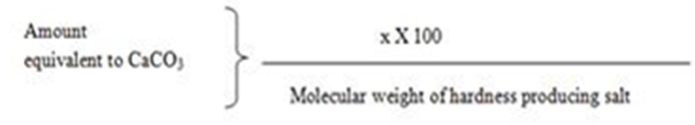
Expression of hardness in terms of
equivalents of CaCO₃
The concentrations of hardness producing salts are usually expressed in terms of equivalent amount of CaCO₃. CaCO₃ is chosen as a standard because, Its molecular weight (100) and equivalent weight (50) is a whole number, so the Calculations in water analysis can be simplified.
It is the most insoluble salt, that can be precipitated in water treatment. If the concentration of hardness producing salt is x mg/lit.

Slide 15
Expression of hardness in terms of equivalents of CaCO₃
CaCO₃ Equivalent Hardness (ppm) =
= Mass of Hardness Producing substance x Chemical equivalents of CaCO₃/ Chemical equivalents of Hardness causing salt.
How many grams of FeSO4 dissolved per litre gives 210 ppm hardness?
Calculate temporary hardness and permanent hardness of water sample from the following data:
Mg(HCO3)2 = 16 mg/L, MgCl2 = 19 mg/L, MgSO4 = 2.4 mg/L, Mg(NO3)2 = 2.96 mg/L, Ca(HCO3)2 = 8.1 mg/L, SiO2 = 16 mg/L

Slide 16
UNITS OF HARDNESS
Parts per million (ppm):
It is defined as the number of parts of CaCO₃ equivalent hardness per 1000000 parts of water.
Milligrams per litre (mg/lit):
It is defined as the number of milligrams of CaCO₃ equivalent hardness per 1 litre of water.

Slide 17
Clarke’s degree (ºCl)
It is defined as the number of parts of CaCO₃ equivalent hardness per 70,000 parts of water.
French degree (ºFr)
It is defined as the number of parts of CaCO₃ equivalent hardness per 105 parts of water.
Relationship between various units
1ppm = 1 mg/lit = 0.10 ºFr = 0.070 ºCl

Slide 18
ESTIMATION OF TOTAL HARDNESS OF WATER BY EDTA METHOD
Principle:
The calcium and other metal ions present in the water is capable of forming complex with Indicator EBT and also with the EDTA in the pH range 8- 10.To keep the solution at this pH range , a buffer [mixture of ammonium chloride and ammonium hydroxide] is used . The complex between EDTA and indicator is more stable that of between the metal ion and indicator.

Slide 19
50 mL SHW = V₁ mL EDTA
50 x 1 mg of CaCO₃ = V1 mL EDTA
Hence, 1 mL EDTA = 50/V₁ mg CaCO₃ eq.
Now 50 mL of given hard water = V₂ mL of EDTA
= V₂ x 50/V₁ mg CaCO₃ eq.
1 L of given hard water = 20 x V₂ x 50/V₁ mg CaCO₃ eq.
Total Hardness of water = 1000 V₂/V₁ ppm
Now, 50 mL of boiled water = V₃ mL of EDTA
= V₃ x 50/V₁ mg CaCO₃ eq.
1 L of boiled hard water = 20 x V₃ x 50/V₁ mg CaCO₃ eq.
Permanent Hardness = 1000 V₃/V₁ ppm

Slide 20
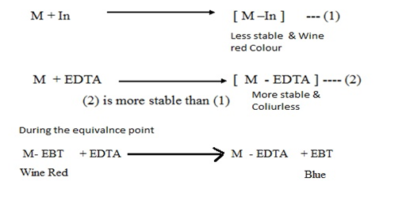

Slide 21
Sample A = 14.6 mg of Mg(HCO3)2 per litre
Sample B = 820 mg of Ca(NO3)2 and 2 mg NaNO3
Sample C = 20 g Silica and 16.2 mg Ca(HCO3)2 per 500 ml
Determine the hardness of samples A, B, C ?

Slide 22
Hardness Numerical
Sr. No. | Type of impurity | Amount of impurity | Molecular mass | M.F. | Equivalence of Ca CO3 Hardness | Hardness Type
1 | Ca(HCO₃)₂ | 8.1 ppm | 162 | 100/162 | 5 ppm | T
2 | Mg(NO3)2 | 14.8 ppm | 148 | 100/ 148 | 10 ppm | P
3 | MgSO4 | 3 ppm | 120 | 100/120 | 2.5 ppm | P
4 | CaCl2 | 2.22 ppm | 111 | 100/111 | 2 ppm | P
5 | KNO3 | 5 ppm | --- | -- | -- | N.H.
6 | FeSO4.7H2O | 5.75 ppm | 278 | 100/278 | 2.06 ppm | P
7 | NaHCO3 | 3 ppm | -- | -- | -- | N.H
 | Temporary Hardness = 5 ppm
 | Permanent Hardness = 16.56 ppm
 | Total Hardness = 21.56 ppm

Slide 23
Numerical on EDTA method
a) 55.5 mg of CaCl2 is dissolved in 750 ml of distilled water and 50 ml of this water on titration required 14 ml of EDTA.
100 ml of water sample on titration with same EDTA required 9.8 ml.
50 ml of boiled water sample on titration required 2.7 ml of same EDTA. Calculate the all types of hardness.

Slide 24
750 ml of SHW = 55.5 mg of CaCl2
= (55.5 / 750) x 100/111 mg of CaCo3
1 ml of SHW = 0.067 mg of CaCO3
50 ml of SHW = 14 ml of EDTA
1 ml of EDTA = 50 /14 ml of SHW
= 50 /14 x 0.067 mg of CaCO3
1 ml of EDTA = 0.24 mg of CaCO3

Slide 25
Total Hardness
100 ml of water sample = 9.8 ml of EDTA = 9.8 x 0.24 mg of CaCO3
Total hardness = 9.8 x 0.24 x 1000/100 mg /L = 23.52 ppm or mg /l

Slide 26
Numerical on EDTA method
b) 0.28 g of CaCO₃ was dissolved in HCl and the solution is diluted to 1 litre. 100 mL of the above solution required 28 mL of EDTA solution.
100 mL of hard water sample required 33 mL of EDTA solution.
After boiling, cooling and filtration 100 mL of this solution on titration required 10 mL of EDTA solution. Calculate all types of hardness.

Slide 27
c) 50 mL sample of water required 8.2 mL of M/20 Disodium EDTA solution for titration. After boiling and filtration the same volume required 4.5 mL of EDTA. Calculate all types of hardness.
M/20 EDTA = 0.05 M EDTA
1000 mL 1 M EDTA = 100 g CaCO₃
1 mL, 1 M EDTA = 100 mg CaCO₃
50 mL water sample = 8.2 mL of 0.05 M EDTA
1000 mL water sample = 20 x 8.2 M of 0.05 M EDTA
= 164 mL of 0.05 M EDTA
1 mL, 1 M EDTA = 100 mg CaCO₃
164 mL of 0.05 M EDTA = 164 x 0.05 x 100 = 820 ppm = Total Hardness

Slide 28
Now, 50 mL of boiled water = 4.5 mL of 0.05 M EDTA
1000 mL water sample = 20 x 4.5 M of 0.05 M EDTA
= 90 mL of 0.05 M EDTA
As, 1 mL, 1 M EDTA = 100 mg CaCO₃
90 mL of 0.05 M EDTA = 90 x 0.05 x 100 = 450 ppm = Permanent hardness
Temporary hardness = 820 – 450 = 370 ppm

Slide 29
d) 25 mL sample of water required 5.5 mL of M/10 Disodium EDTA solution for titration. After boiling and filtration 50 mL of water sample required 3.9 mL of EDTA. Calculate all types of hardness.

Slide 32
BOD (Biological Oxygen Demand)
It is a measure of amount of oxygen required for the biological oxidation of organic matter under aerobic conditions at 20⁰ C for a period of 5 days.
Organic matter + O₂ Micro-organisms CO₂ + H₂O
BOD is the direct measurement of extent of pollution in waste water & industrial effluent.
Only applicable for bio-degradable pollutants.
Higher the BOD, higher will be the level of pollutants in water.
Drinking water should have BOD less than 1 ppm.

Slide 33

Principle
Dissolved oxygen content of diluted waste-water is determined at the beginning of the reaction by Winkler’s method or by DO meter.
Same sample of water is kept for incubation in the presence of micro-organisms for 5 days at 20⁰ C and decrease in the dissolved oxygen content is determined by Winkler’s method or by DO meter.
BOD = [(DO)_{Blank} – (DO)_{Incubated} ] X Dilution Factor
(DO)_{Blank} = Dissolved oxygen of diluted sample in the beginning of the reaction
(DO)_{Incubated} = Dissolved oxygen of diluted sample after incubation for 5 days at 20 ⁰ C.

Slide 34
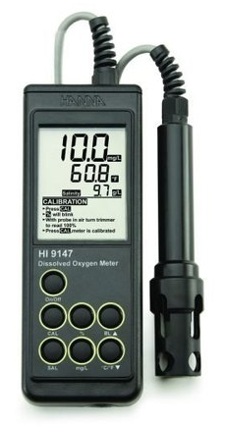
BOD Meter

Slide 35
Significance of BOD
BOD gives the extent of bio-degradable pollutants in wastewater sample
It also helps in pollution control in water
It also express self-purification capacity of any water body.

Slide 36
COD (Chemical Oxygen Demand)
It is a measure of amount of oxygen required for the chemical oxidation of organic matter when refluxed in acidified potassium dichromate in the presence of Ag₂SO₄ or HgSO₄ catalyst for 3 hours.
CxHyOz + (X + Y/4 – Z/2) O₂ X CO₂ + (Y/2) H₂O
(Organic matter) [O]
COD is the direct measurement of extent of pollution in waste water & industrial effluent.
Applicable for both bio-degradable and non bio-degradable pollutants.
Higher the COD, higher will be the level of pollutants in water.
Drinking water should have COD less than 1 ppm.

Slide 37
Principle
A known volume of waste water sample (say 250 ml) is refluxed with a known excess of standard potassium dichromate (1 N) and dilute/conc. sulfuric acid mixture in the presence of silver sulphate catalyst for about 3 hours.
This oxidases organic matter to CO₂, NH₃ and H₂O.
The unreacted potassium dichromate is titrated against Ferrous ammonium sulphate (Mohr’s salt) with ferroin indicator till blue colour changes to wine red, the reading is (Vt).
This gives the amount of potassium dichromate consumed (in terms of equivalent oxygen) required for degradation of organic pollutants.
Blank titration is performed initially with known volume of waste water sample and added acidified standard potassium dichromate titrated against Ferrous ammonium sulphate (Mohr’s salt) with ferroin indicator till blue colour changes to wine red, the reading is (Vb) (zero minute reading)

Slide 38
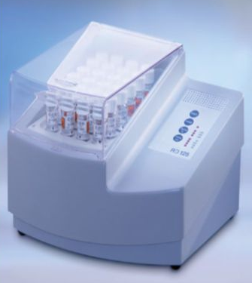
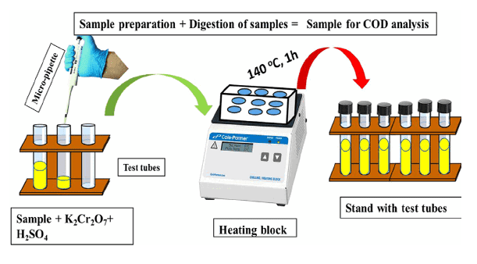
COD Meter

Slide 39
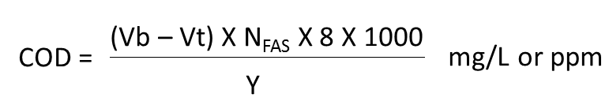
Principle
Vb = Volume of FAS required for blank titration (Zero time)
Vt = Volume of FAS required for reaction mass after time (t)
Y = Volume of waste water sample taken

Slide 40
Significance of COD
COD gives the extent of pollution caused by bio-degradable and non bio-degradable pollutants in wastewater sample
It helps in rapid determination of pollutants level in water compared to BOD
It is taken as a basis for calculation of efficiency and designing of water treatment plants.

Slide 41
Comparison between BOD and COD
BOD | COD
It measures oxygen demand of bio-degradable organic pollutants only | It measures oxygen demand of bio-degradable and non biodegradable organic pollutants
Less stable measurement technique as micro-organisms are susceptible to variables such as pH and temperature | More stable measurement technique as no micro-organisms are used and potassium dichromate oxidizes any type of organic pollutants in water
Slow process, takes 5 days | Fast process , takes 3 hours
BOD values are generally less than COD values | COD values are generally greater than BOD values

Slide 42
Formulae
1. BOD = [(DO)_{Blank} – (DO)_{Incubated} ] x Dilution Factor
(DO)_{Blank} = Dissolved oxygen of diluted sample in the beginning of the reaction
(DO)_{Incubated} = Dissolved oxygen of diluted sample after incubation for 5 days at 20 ⁰ C.
2.
Vb = Volume of FAS required for blank titration (Zero time)
Vt = Volume of FAS required for reaction mass after time (t)
Y = Volume of waste water sample taken

Slide 43
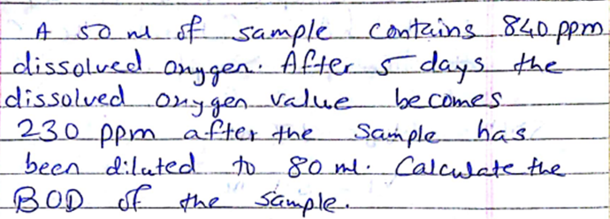

Slide 44
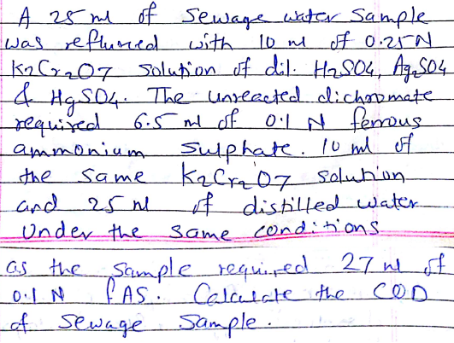

Slide 45
Activated Sludge Method (Sewage Treatment)
Sewage includes household waste, ground waste, street waste and some industrial waste water.
It is necessary to treat Sewage waste-water to reduce its pollutant level before releasing it into any water bodies.
This is because to prevent further pollution of water bodies and to protect aquatic life.
This method is an aerobic treatment of sewage water or industrial waste water, before releasing it into lake, river or sea.

Slide 46
Activated Sludge Method
This is a step-wise process involves following steps:
Preliminary Treatment
Primary Treatment
Secondary (Biological) Treatment
(Activated Sludge / Trickling Filters)
Tertiary Treatment

Slide 47
Preliminary Treatment
The principle behind this step is to remove large floating and suspended solid matter like plastic, rubber, clothes, grit, oil and greases etc.
For the removal of such large size matter the sewage water is allowed to pass through bar screens and mesh screens

Slide 48
Primary Treatment
This step is the sedimentation step, in which with the help of flocculants (Alum, lime), small size suspended matter is allowed to settle down.
Small particles (colloidal size) are converted / coagulated into big particles and allowed to settle

Slide 49
Secondary (Biological) Treatment
This step involves biological oxidation, filtration and activated sludge method.
Sewage water gets filtered through specially design sprinkling filters, which ensures aerobic conditions throughout.
Trickling filters are used for the biological oxidation of sewage.
Sewage is delivered to this filters through rotating distributor

Slide 50
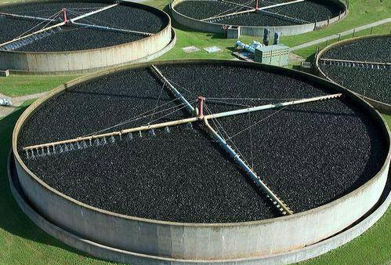
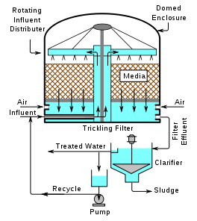
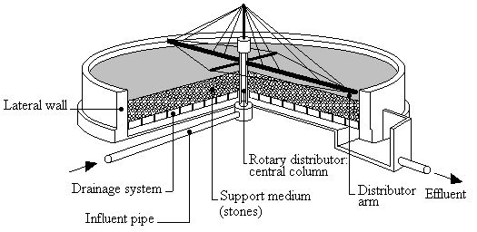

Slide 51
(Activated Sludge / Trickling Filters)
Trickled sewage water starts percolating downwards, the aerobic bacteria grows on the surface, this carries biological oxidation.
The sludge from the above oxidation process is known as activated sludge.
This activated sludge can be used multiple times for further sewage treatments.

Slide 52
Tertiary Treatment
This step is used to decrease the load of nitrogen, phosphorous and micro-organisms from the treated sewage water.
Precipitation: Treatment of water with lime which reacts with phosphorus to form calcium phosphate
Nitrogen stripping: It is carried out to remove ammonia gas
Chlorination: The water is treated with hypo-chlorus acid or ClO₂ or bleaching powder in order to remove micro-organisms in the treated water
Finally water can be discharged into river, lake or sea

Slide 53
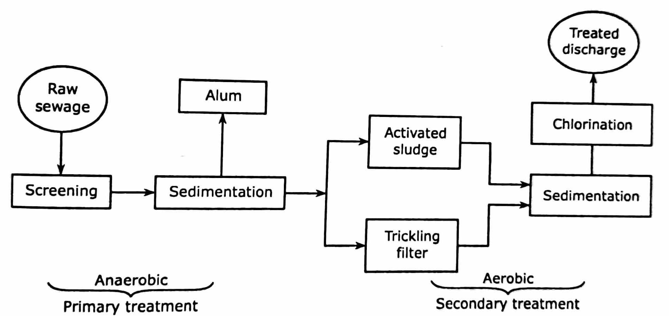

Slide 54
Waste Water Treatment Plant:
General method-
https://www.youtube.com/watch?v=ciPFC3Y2rkg
NYC Plant-
https://www.youtube.com/watch?v=FvPakzqM3h8
Kerala Plant-
https://www.youtube.com/watch?v=1e85WmSODmk

